Slide 1
Deploy a container to Bluemix
Can be created from IBM images or images that you create
Images can be deployed as a single container or as scalable container groups
In the lab exercise, you will build a jar file for the inventory microservice with the provided source code in your local environment
Then you will build a docker image locally that contains the inventory microservice. The inventory jar file will be added to a standard Docker java base image, and the New Relic monitoring agent will be added as well
Tag your image
  Tagging is used for image management. Might want to tag with the version of code the image contains, source code repo branch name, etc.
Upload or ‘push’ the image to your Bluemix repository
Run the container group

Slide 2








Deploy the container
Step 1: User gradle to build the inventory app jar file
Step 2: Create a docker image locally with java 8, New Relic agent, and the inventory app
Step 3: Tag the image
: inventoryservice-${SUFFIX}
Step 4: Push the image to your Bluemix repo
Step 5: Create and run the container group in Bluemix
Inventory app
New Relic agent
Docker Java 8
Inventory app
New Relic agent
Docker Java 8
public
corporate data center
container
Secure Gateway
Client
IAnventory app
New Relic agent
Docker Java 8

Slide 3
Create the container group in Bluemx
-p: Port
-m memory limit for the container in MB
--min: minimum number of instances in group
--desired: desired number of instances
--auto: Enable auto recovery
--name: The name for the group
-e: set environment variable. Each environment variable is a key value pair
-n: The host name
-d: The domain name for the group. The host and the domain combined form the full public route URL
The image to include in each container in the group is the last
cf ic group create -p 8080 -m 256 --min 1 --desired 1 \
--auto --name micro-inventory-group-${SUFFIX} \
-e "spring.datasource.url=jdbc:mysql://${ipaddr}:3306/inventorydb" \
-e "spring.datasource.username=dbuser" \
-e "spring.datasource.password=Pass4dbUs3R" \
-n inventoryservice-${SUFFIX} -d mybluemix.net \
registry.ng.bluemix.net/$(cf ic namespace get)/inventoryservice-${SUFFIX}
Notes:
When auto-recovery is enabled for a container group, IBM Containers checks the health of each instance with an HTTP request to the port that is assigned. If no TCP response is received from a container instance in two subsequent 90-second intervals, the instance is removed and replaced with a new instance. For more information about the health check, see the --http_monitor_enabled option. If the health check does not receive a TCP response from a container instance in two subsequent 90-second intervals, the instance is removed and replaced with a new instance. No action is taken if the container responds. This process is repeated continuously. If during a 30-minute window, the total number of different containers that were members of the group, equals, or exceeds three times the maximum size of the group, automatic recovery is disabled permanently for the container group. To enable automatic recovery again, you must re-create the container group.

Slide 4
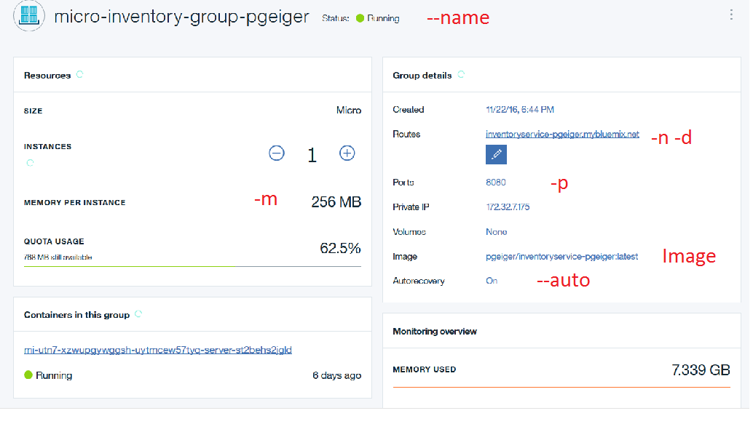
Container Group

